Slide 1
2025 System Performance Measures Homeward/Polk County
Presenter: Susie MCCarragher, system administrator

Slide 2
Acronyms
ES: Emergency Shelter (includes both ES types)
ES-EE: Emergency Shelter Entry-Exit
ES-NbN: Emergency Shelter Night by Night
SH: Safe Haven
TH: Transitional Housing
SO: Street Outreach
PH: Permanent Housing (including Permanent Supportive Housing (PSH), Other Permanent Housing (OPH), and Rapid Rehousing (RRH))
Universe: clients being reported on in the given measure
COC: Continuum of Care
SPMs: System Performance Measures
LSA: Longitudinal System Analysis

Slide 3
The Longitudinal System Analysis (LSA)

Slide 4
The ‘What’ and the ‘Why’
The Longitudinal Systems Analysis (LSA) report provides HUD and Continuums of Care (CoCs) with critical information about how people experiencing homelessness use their system of care.
Due yearly to HUD
Reporting from 10/01/2024 to 09/30/2025
Reports on all data in the HMIS system for ES, TH, SH, RRH, OPH, and PSH projects.
Does not include data from DVIMS or non-participating projects.
Does not include street outreach projects.
Focus on viewing HMIS as a coordinated system of assistance.

Slide 5
LSA Overview (Stella P)
From 10/01/2024 though 09/30/2025
4,353 people served in the homeless system in 3,451 households
71 days on average homeless (based on 3,191 households)
28% Exited to Permanent Destinations (based on 2,448 households)
25% Adult Only Households
64% Adult & Child Households
10% of households that exited during the first six months of the report period returned to homelessness
10/01/2024 through 3/31/2025

Slide 6
LSA Pathways (Stella P)
Pathways are a combination of project types (ES, SH, TH, RRH, OPH, and PSH) that a household is enrolled in during the reporting period.
Most Used Pathways:
(percentage of the 3,191 households enrolled)
ES/SH Only: 68%
ES/SH + RRH: 9%
RRH Only: 8%
TH Only and PSH Only: 6%
ES/SH + TH: 2%
Most Successful Pathways
(percentage of exits to permanent housing)
ES/SH + RRH: 82% (of 197 households)
RRH Only: 72% (of 143 households)
PSH Only: 34% (of 73 households)
TH Only: 15% (of 91 households)
ES/SH Only: 20% (of 1886 households)
ES/SH + TH: 7% (of 29 households)

Slide 7
The System Performance Measures (SPMs)

Slide 8
The ‘What’ and the ‘Why’
The System Performance Measures (SPMs) report on 7 system-level measures to help communities understand how their HMIS system functions.
Due yearly to HUD
Reporting from 10/01/2024 to 09/30/2025
Reports on all data in the HMIS system for ES, SO, TH, SH, and PH projects.
Does not include data from DVIMS or non-participating projects.
CoCs are charged with designing a local ‘system’ to assist people experiencing homelessness.
Requires viewing the local homeless response as an integrated system of homeless assistance.
SPMs ensure a common understanding of system intent and goals.
Focus on measuring the cumulative and collective impact of programs.
Identify areas for improvement.
Fosters accountability to the community for how well the entire system prevents and ends homelessness for community members.
Notes:
Resources:
- https://files.hudexchange.info/course-content/preparing-for-hud-s-system-performance-measures-webinar1/Preparing-for-HUDs-System-Performance-Measures-Webinar-Slides-2016-06-07.pdf

Slide 9
The SPMs Overview
Measure 1: Length of Time Persons Remain Homeless
Measure 2: The Extent to which Persons who Exit Homelessness to Permanent Housing Destinations Return to Homelessness
Measure 3: Number of Homeless Persons
Measure 4: Employment and Income Growth for Homeless Persons in CoC Program-funded Projects
Measure 5: Number of Persons who Become Homeless for the First Time
Measure 6: only for COCs given permission by HUD to serve category 3 of HUD’s Homeless Definition
Measure 7: Successful Placement from Street Outreach and Successful Placement in or Retention of Permanent Housing

Slide 10
Measure 1: Length of Time Persons Remain Homeless
Desired Outcome: Reduction in the average and median length of time persons remain homeless from one year to the next.
Universe:
Metric 1.1: People in ES and SH during the reporting period who exited during or remained beyond the reporting period.
Metric 1.2: People in ES, SH, and TH during the reporting period who exited during or remained beyond the reporting period.
Metric 1.1b and 1.2b include PH projects
Measures: Average and Median length of time that persons are homeless
Metric 1.1: Change in the average and median length of time persons are homeless in ES and SH projects.
Metric 1.2: Change in the average and median length of time persons are homeless in ES, SH, and TH projects.

Slide 11
Metric 1.1a – ES and SH

Slide 12
Metric 1.2a – ES, SH, & TH

Slide 13
Metric 1.1b – ES, SH, & PH

Slide 14
Metric 1.2b – ES, SH, TH, & PH

Slide 15
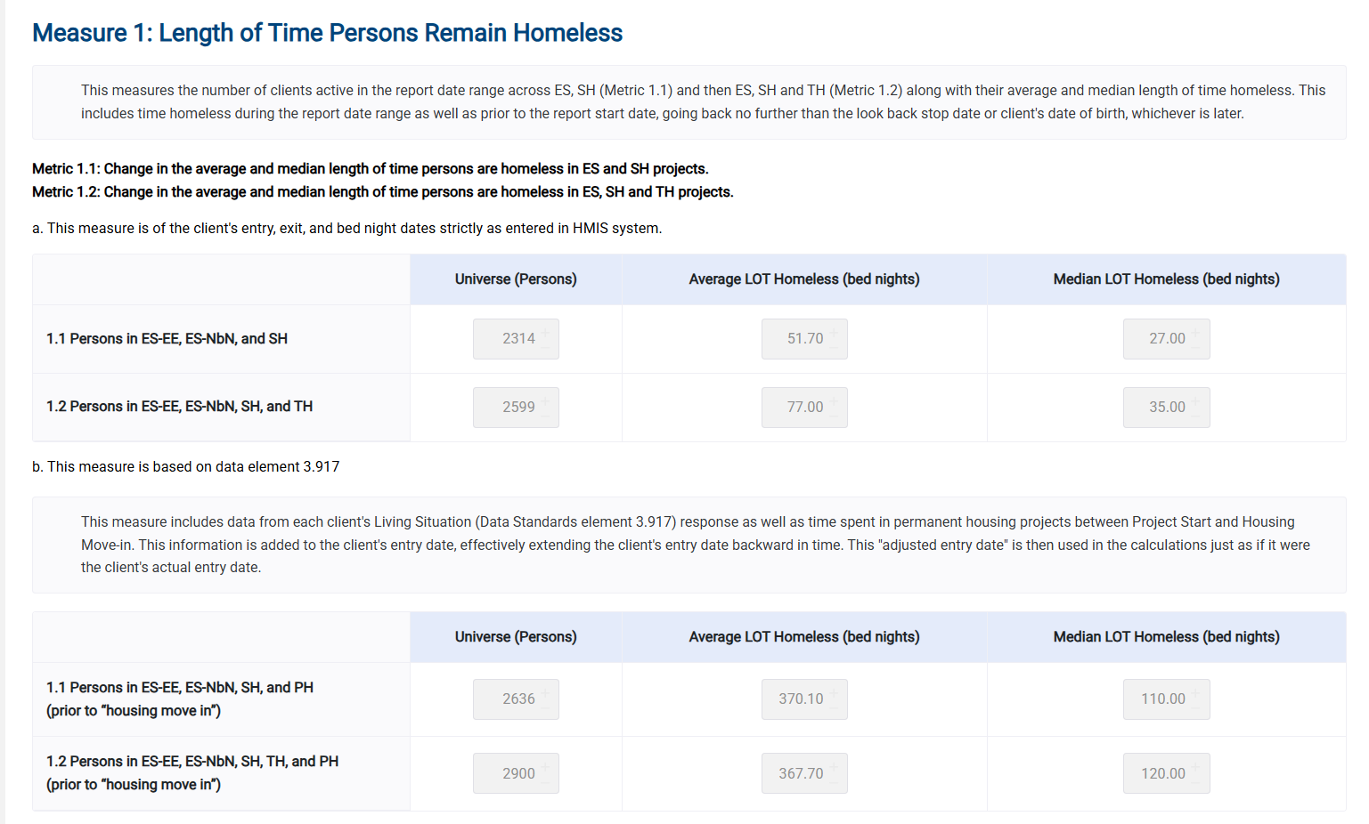

Slide 16
Measure 2: The Extent to which Persons who Exit Homelessness to Permanent Housing Destinations Return to Homelessness
Desired Outcome: Reduction in the percentage of people who return to homelessness.
Universe: Persons in SO, ES, TH, SH, and any PH project type who exited to permanent housing destinations during the 2 years prior to this reporting period.
Exited during 10/01/2022 – 09/30/2023
Measures: The percentage of people who exited to permanent housing destinations, and then returned to homelessness within less than 6 months, 6-12 months, and 13-24 months.

Slide 17
Metric 2 – Street Outreach

Slide 18
Metric 2 – Emergency Shelter

Slide 19
Metric 2 – Transitional Housing

Slide 20
Metric 2 – Safe Haven

Slide 21
Metric 2 – Permanent Housing

Slide 22
Metric 2 – All Project Types

Slide 23
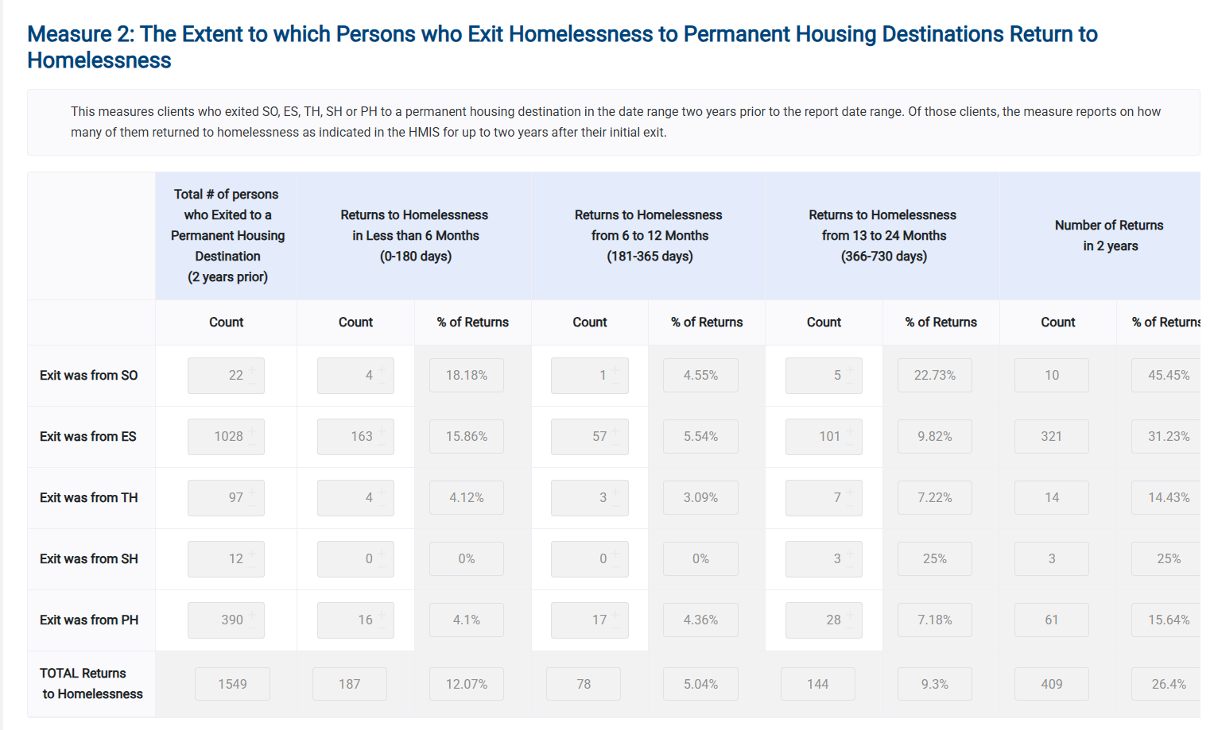

Slide 24
Measure 3: Number of Homeless Persons
Desired Outcome: Reduction in the number of persons who are homeless.
Universe:
Metric 3.1 Change in PIT Counts: Persons counted as sheltered and unsheltered in the PIT (1/29/2025) count conducted during the reporting period.
Metric 3.2 Change in Annual Counts: Persons in ES, SH, and TH project types during the reporting period.
Measures: Number of people who were homeless on the night of the PIT or during the reporting period as per HMIS enrollments in ES, SH, and TH projects.

Slide 25
Metric 3.1- PIT Count Homeless

Slide 26
Metric 3.2- Annual Count Homeless

Slide 27
Measure 4: Employment and Income Growth for Homeless Persons in CoC Program-funded Projects
Desired Outcome: Increase in the percent of adults who gain or increase employment or non-employment cash income over time.
Universe: Adults in CoC Program-funded project types who…
Metric 4.1, 4.2, and 4.3: have been in HMIS for at least a year and are still in the system at the end of the reporting period (system stayers).
Metric 4.4, 4.5, and 4.6: have exited during the reporting period (system leavers).
Measures:
Metric 4.1: Change in earned income for adult system stayers during the reporting period.
Metric 4.2: Change in non-employment cash income for adult system stayers during the reporting period.
Metric 4.3: Change in total income for adult system stayers during the reporting period.
Metric 4.4: Change in earned income for adult system leavers.
Metric 4.5: Change in non-employment cash income for adult system leavers.
Metric 4.6: Change in total income for adult system leavers.

Slide 28
Metric 4.1, 4.2, 4.3

Slide 29
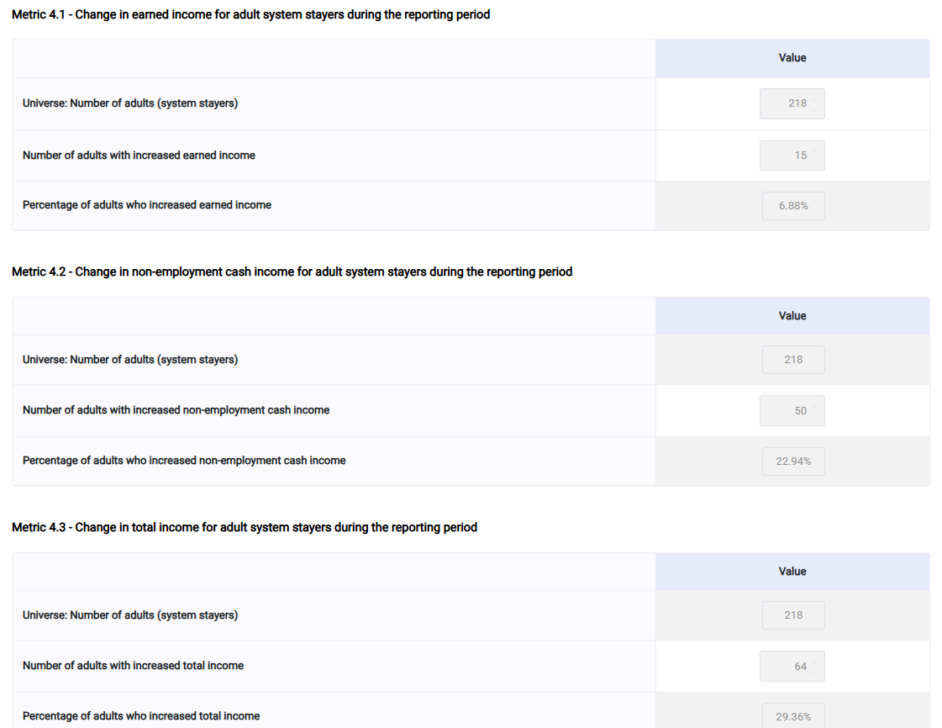

Slide 30
Metric 4.4, 4.5, 4.6

Slide 31
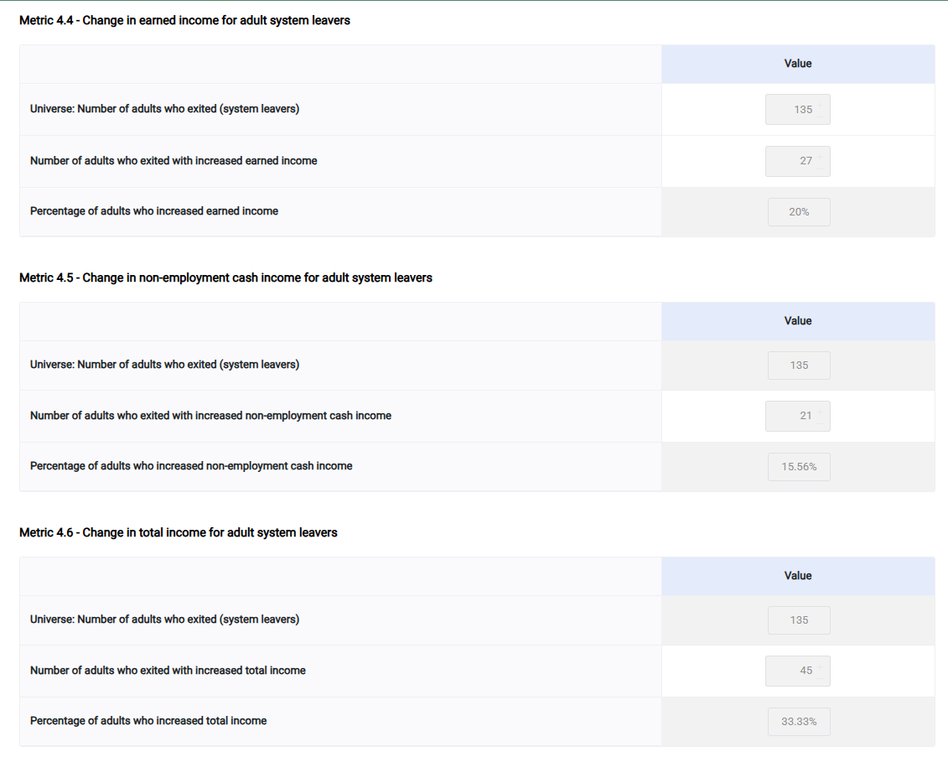

Slide 32
Measure 5: Number of Persons who Became Homeless for the First Time
Desired Outcome: Reduction in the number of persons who become homeless for the first time.
Universe:
Metric 5.1: Person with entries into ES, SH, or TH during the reporting period.
Metric 5.2: Person with entries into ES, SH, TH, or PH during the reporting period.
Measures: Number of persons experiencing homelessness for the first time.
Metric 5.1 - Change in the number of persons entering ES, SH, and TH projects with no prior enrollments in HMIS.
Metric 5.2 - Change in the number of persons entering ES, SH, TH, and PH projects with no prior enrollments in HMIS.

Slide 33
Metric 5.1 – ES, SH, & TH

Slide 34
Metric 5.2 – ES, SH, TH, PH

Slide 35
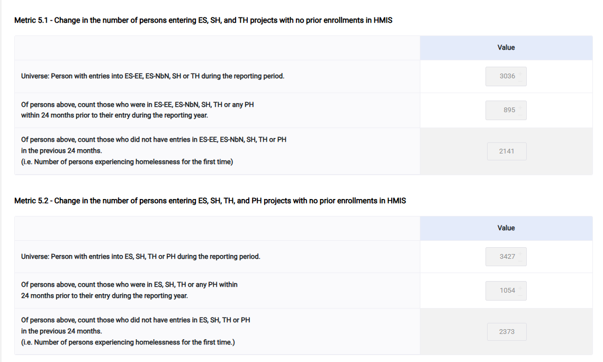

Slide 36
Measure 7a: Successful Placement from Street Outreach to Sheltered Situations
Desired Outcome: Increase in the percentage of persons who exit to an ES, SH, TH, some temporary destinations, or permanent housing destination.
Universe: Persons who exited Street Outreach during the reporting period.
Measures: Exits to permanent housing destinations, temporary housing destinations, or to some institution destinations.
Most anywhere that is sheltered is considered a positive destination, as the person is no longer living in a place that is not meant for human habitation.

Slide 37
Metric 7a

Slide 38
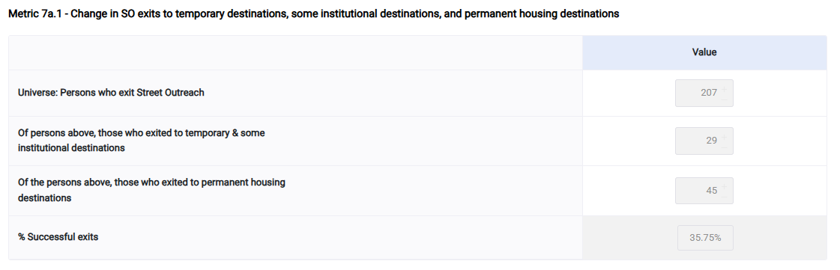

Slide 39
Measure 7b: Successful Placement in or Retention of Permanent Housing
Desired Outcome: Increase in the percentage of persons who exit to or retain permanent housing.
Universe:
Metric 7b.1: Persons in ES, SH, TH, and RRH projects who exited during the reporting period.
Metric 7b.2: Persons in all PH project types (except RRH) who exited, moved into, or remained in permanent housing during the reporting period.
Measures: Exits to permanent housing destinations or retention of permanent housing.

Slide 40
Metric 7b.1 – ES, SH, TH, & RRH exits

Slide 41
Metric 7b.2 – Exit/Retention of OPH, PSH

Slide 42
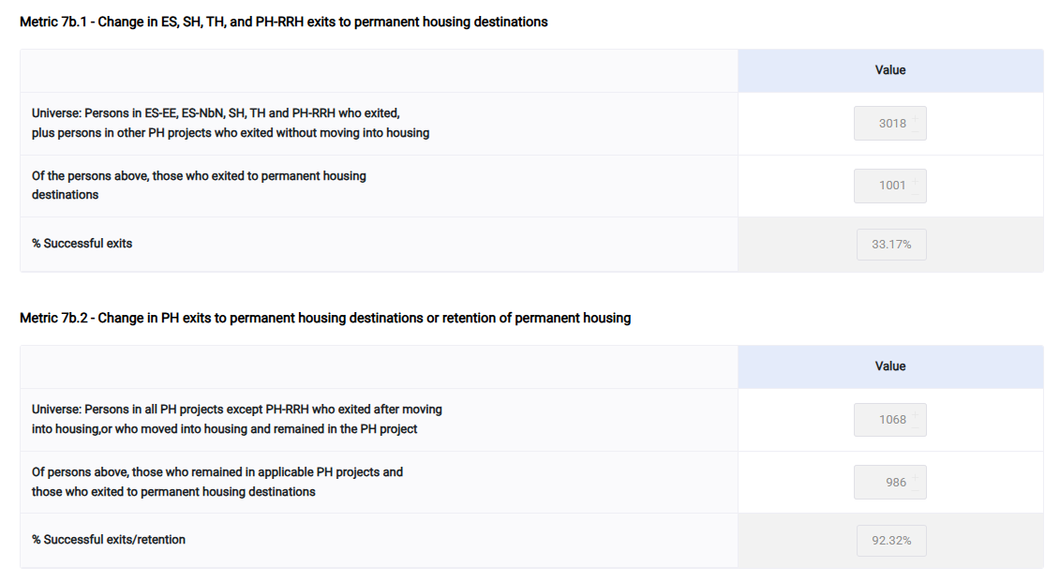

Slide 43
Questions?
Email: support@icalliances.org

